Slide 1
Flood Monitoring System Using Esp8266 And Ultra Sonic Sensor Programmed In Ardiuno Application
SlideMake.com

Slide 2
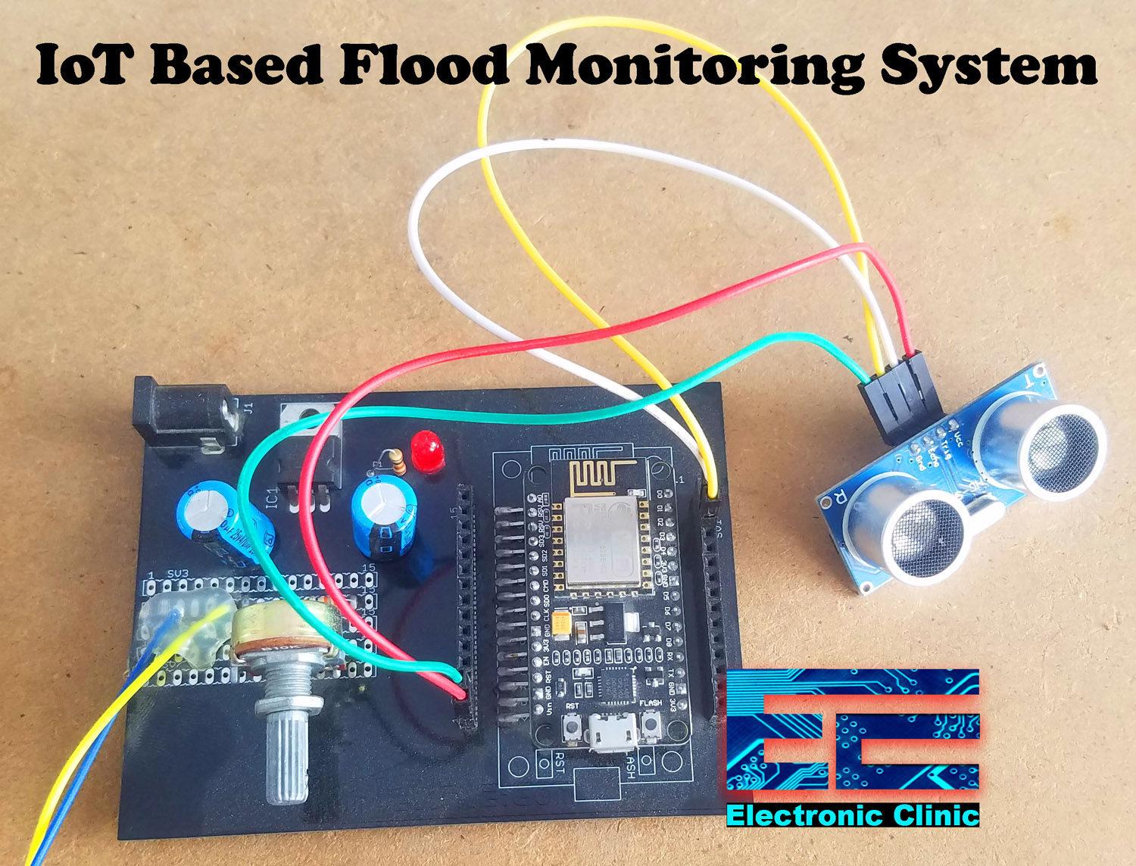
Introduction
Flood monitoring system using esp8266 and ultra sonic sensor programmed in Arduino Application is an innovative solution to detect and monitor flood levels in real-time.
This system combines the power of esp8266, a Wi-Fi module, and an ultra sonic sensor to accurately measure the water level.
The data collected by the system can be used to provide early warnings, mitigate damages, and improve emergency response.
Notes:
Image source: https://www.electroniclinic.com/iot-based-flood-monitoring-system-using-ultrasonic-sensor-and-esp8266/

Slide 3
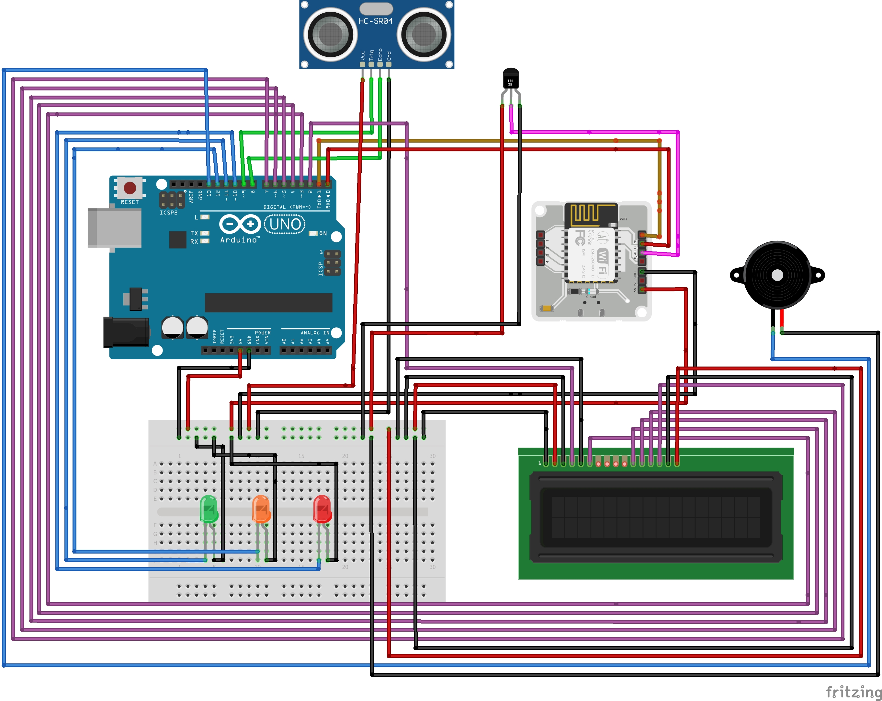
Components
The main components of the flood monitoring system include:
- ESP8266: A Wi-Fi module that enables wireless connectivity and data transmission.
- Ultra Sonic Sensor: Measures the distance to a water surface and calculates the water level based on the reflected sound waves.
- Arduino: Used as the microcontroller to program and control the system.
Notes:
Image source: https://create.arduino.cc/projecthub/vaibhavshanbhag467/iot-based-flood-monitoring-and-alerting-system-e03cff

Slide 4
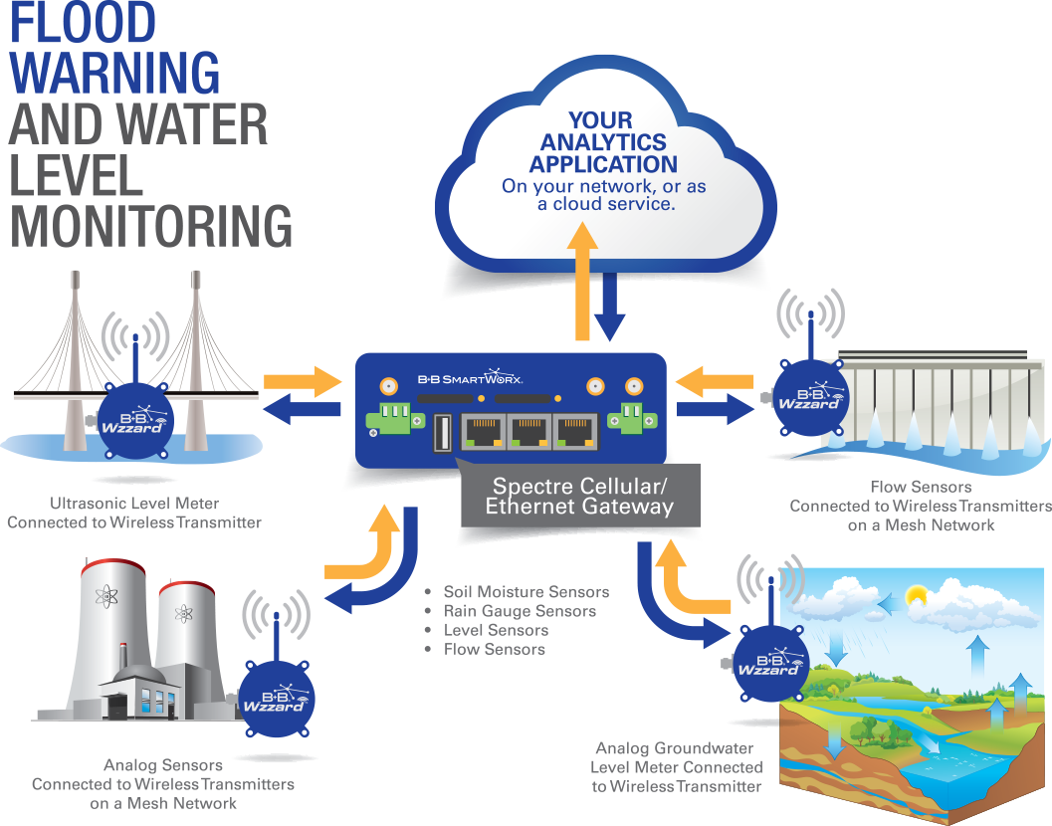
System Architecture
The flood monitoring system follows a simple architecture:
- The ultra sonic sensor is connected to the Arduino for measuring the water level.
- The Arduino is programmed to process the sensor data and communicate with the esp8266 module.
- The esp8266 module sends the data to a cloud platform or a local server for further analysis and visualization.
Notes:
Image source: https://advantech-bb.com/smart-iot-technology-for-flood-and-water-level-monitoring/

Slide 5
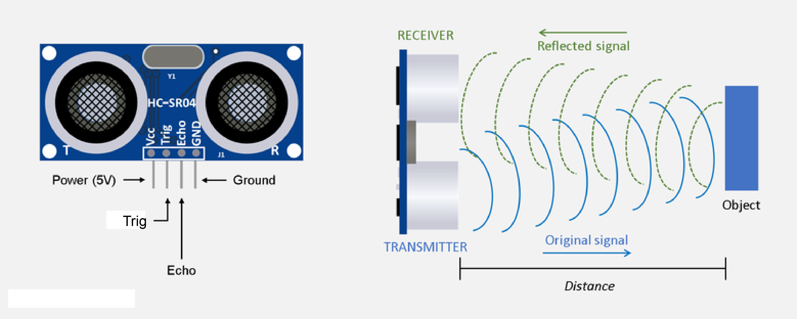
Sensor Operation
The ultra sonic sensor operates by emitting sound waves and measuring the time it takes for the waves to return after bouncing off the water surface.
The Arduino calculates the distance based on the time and converts it into a water level measurement.
The accuracy of the measurement depends on factors such as sensor placement and environmental conditions.
Notes:
Image source: https://osoyoo.com/2018/09/18/micro-bit-lesson-using-the-ultrasonic-module/

Slide 6
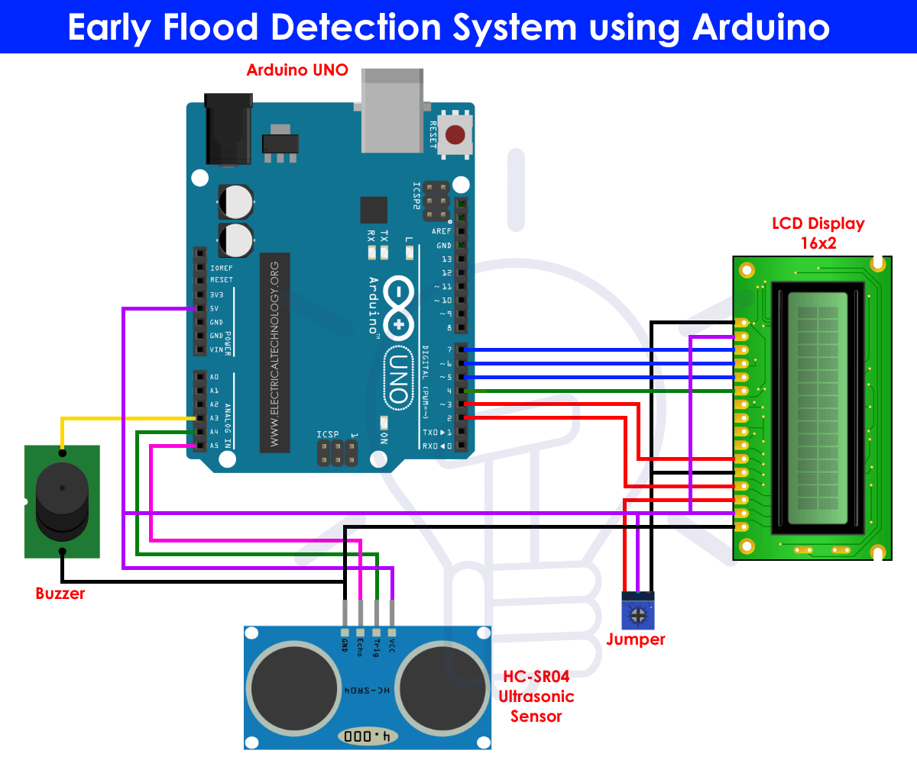
Arduino Programming
The Arduino code for the flood monitoring system includes:
- Configuring the sensor and esp8266 module.
- Reading the sensor data and converting it into a water level measurement.
- Establishing a Wi-Fi connection and sending the data to the cloud or local server.
- Implementing error handling and data validation.
Notes:
Image source: https://www.vrogue.co/post/flood-detection-object-detection-dataset-by-ai

Slide 7
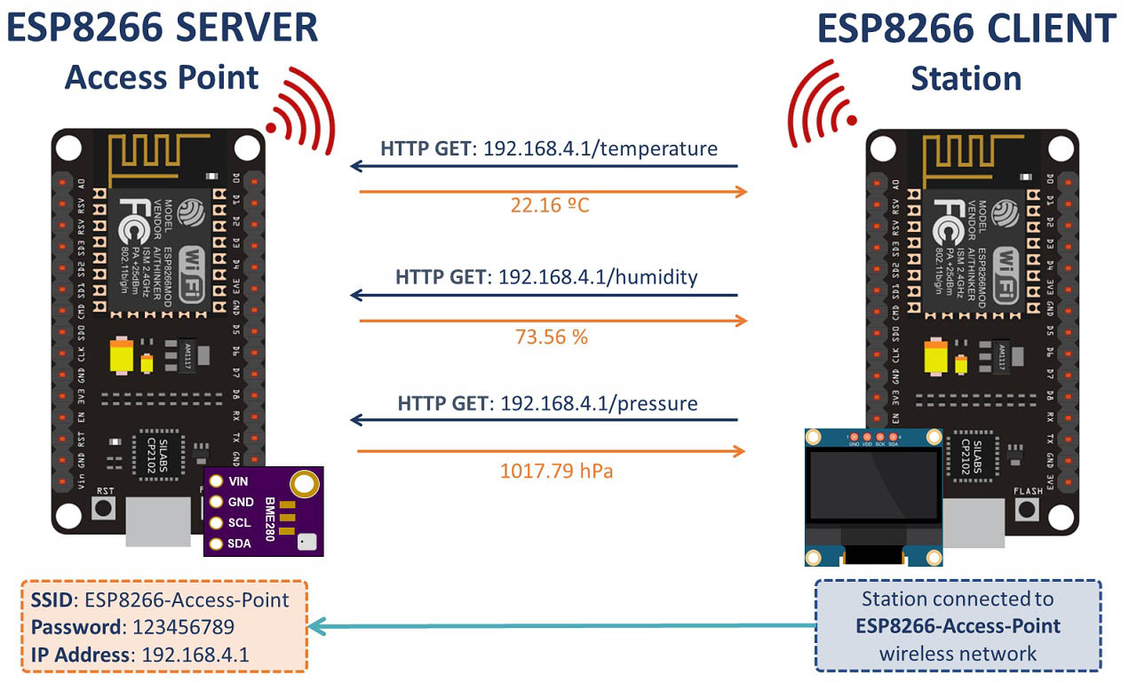
Communication with esp8266
The esp8266 module is responsible for establishing a Wi-Fi connection and transmitting the data to a remote server.
It can use protocols like HTTP or MQTT to communicate with the server.
The module needs to be configured with the appropriate credentials, such as Wi-Fi network name and password.
Notes:
Image source: https://gndtovcc.home.blog/2020/04/12/esp8266-client-server-wi-fi-communication-between-two-boards-nodemcu/

Slide 8
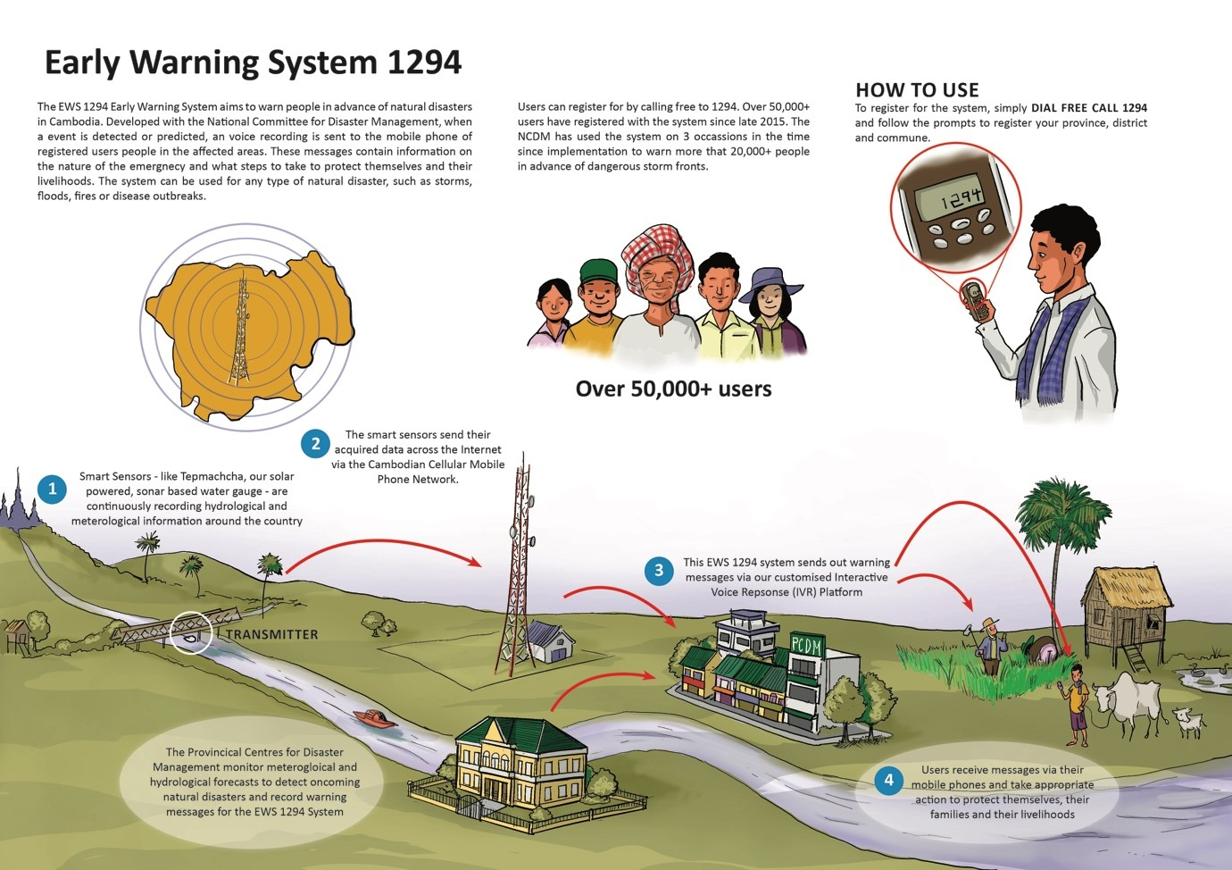
Data Visualization
The flood monitoring system can provide real-time data visualization through a web-based dashboard or a mobile application.
The data can be displayed in the form of graphs, charts, or maps for easy interpretation.
Historical data can also be stored and analyzed for trend analysis and forecasting.
Notes:
Image source: https://laptrinhx.com/tepmachcha-an-open-source-ultrasonic-stream-gauge-flood-warning-system-3803907408/

Slide 9
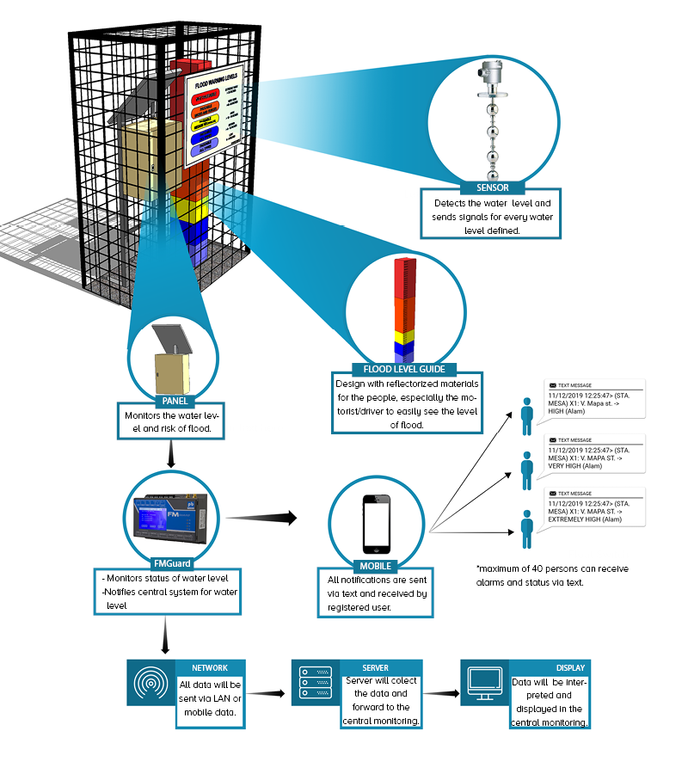
Alerting and Notifications
The flood monitoring system can be configured to send alerts and notifications based on predefined thresholds.
When the water level exceeds a certain threshold, an alert can be triggered to notify the authorities or residents in the affected area.
Notifications can be sent via SMS, email, or push notifications to ensure timely response.
Notes:
Image source: https://linkwisetech.com/applications/flood-monitoring-system/

Slide 10
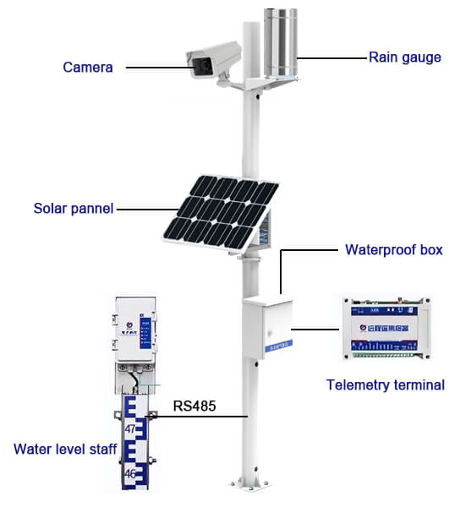
Power Management
Power management is a crucial aspect of the flood monitoring system.
The system can be designed to operate on battery power, ensuring continuous monitoring even during power outages.
Low power modes and optimization techniques can be implemented to prolong the battery life.
Notes:
Image source: https://www.renkeer.com/flood-warning-system/

Slide 11

Deployment Considerations
When deploying the flood monitoring system, several factors should be considered:
- Sensor placement: It should be strategically positioned to accurately measure the water level.
- Connectivity: Availability of a stable Wi-Fi network or alternative connectivity options.
- Maintenance: Regular sensor calibration and system checks to ensure optimal performance.
Notes:
Image source: https://avtech.com/articles/16967/protect-your-organization-from-water-leaks-and-flooding-with-room-alert/flood_monitoring_infographic_190129/

Slide 12
Benefits of the System
The flood monitoring system offers various benefits:
- Early warning: Enables timely evacuation and minimizes damages.
- Real-time monitoring: Provides up-to-date information on flood levels.
- Data-driven decision-making: Helps authorities plan and allocate resources more effectively.
Notes:
Image source: https://avtech.com/articles/16967/protect-your-organization-from-water-leaks-and-flooding-with-room-alert/flood_monitoring_infographic_190129/

Slide 13
Limitations
Despite its advantages, the flood monitoring system has certain limitations:
- Accuracy: The measurement accuracy may be influenced by factors like sensor calibration and environmental conditions.
- Infrastructure requirements: Reliable connectivity and power sources are necessary for continuous operation.
- Cost: The system cost may vary depending on the chosen components and deployment scale.
Notes:
Image source: https://advantech-bb.com/smart-iot-technology-for-flood-and-water-level-monitoring/

Slide 14
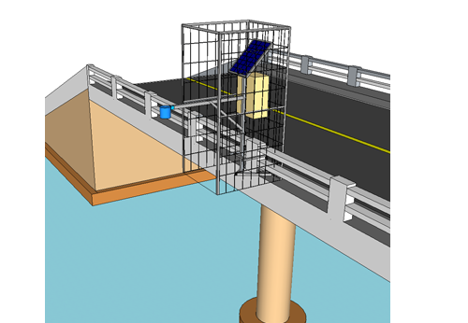
Applications
The flood monitoring system can be deployed in various applications:
- Urban areas prone to floods: Helps in urban planning and disaster management.
- River monitoring: Monitors river levels to prevent flooding in downstream areas.
- Infrastructure protection: Protects critical infrastructure like bridges and dams.
Notes:
Image source: https://linkwisetech.com/applications/flood-monitoring-system/

Slide 15
Future Enhancements
The flood monitoring system can be further improved:
- Integration with other sensors: Adding rainfall and weather sensors for better flood prediction.
- Machine learning algorithms: Enhancing data analysis capabilities for more accurate flood forecasting.
- Mobile app integration: Providing users with real-time updates and personalized alerts.
Notes:
Image source: https://avtech.com/articles/16967/protect-your-organization-from-water-leaks-and-flooding-with-room-alert/flood_monitoring_infographic_190129/

Slide 16
Conclusion
The flood monitoring system using esp8266 and ultra sonic sensor programmed in Arduino Application is a reliable and cost-effective solution for real-time flood monitoring.
With its ability to provide accurate measurements, early warnings, and data visualization, it plays a crucial role in mitigating the impact of floods.
Continuous improvements and advancements in sensor technology will further enhance the effectiveness of such systems.
Notes:
Image source: https://www.electroniclinic.com/iot-based-flood-monitoring-system-using-ultrasonic-sensor-and-esp8266/

